Slide 1
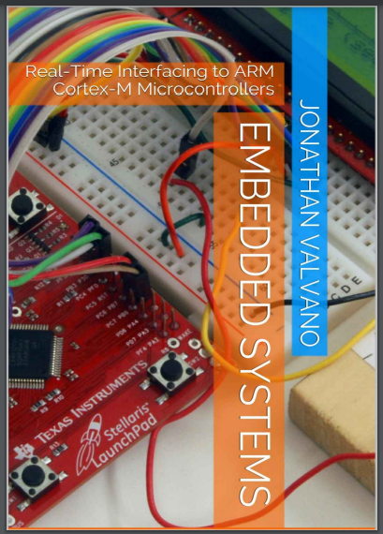

Slide 2
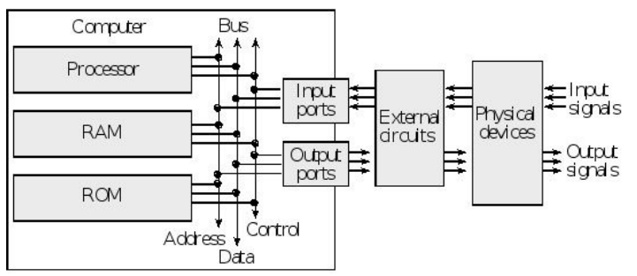
Embedded Systems
An embedded system is an electronic system that includes a one or more microcontrollers that is configured to perform a specific dedicated application.
Software
Processor
Microprocessor
Microcontroller
RAM – Static RAM
Embedded means “a computer is hidden inside so one can’t see it.”
The word “system” refers to the fact that there are many components which act in concert achieving the common goal.
Input/output devices characterize the embedded system, allowing it to interact with the real world.
Von Neumann architecture
Notes:
Software is an ordered sequence of very specific instructions that are stored in memory, defining exactly what and when certain tasks are to be performed.
processor executes the software by retrieving and interpreting these instructions one at a time.
For example, Intel Xeon, AMD FX and Sun SPARC are microprocessors.
the Atmel ATtiny, the Texas Instruments MSP430, and the Texas Instruments TM4C123 are examples of microcontrollers.
The computer can store information in RAM by writing to it, or it can retrieve previously stored data by reading from it. Most RAMs are volatile; meaning if power is interrupted and restored the information in the RAM is lost. Most microcontrollers have static RAM (SRAM) using six metal-oxide-semiconductor field-effect transistors (MOSFET) to create each memory bit. Four transistors are used to create two cross-coupled inverters that store the binary information, and the other two are used to read and write the bit.
ROMs are nonvolatile; meaning if power is interrupted and restored the information in the ROM is retained.
Some ROMs are programmed at the factory and can never be changed.
A Programmable ROM (PROM) can be erased and reprogrammed by the user, but the erase/program sequence is typically 10000 times slower than the time to write data into a RAM.
PROMs used to need ultraviolet light to erase, and then we programmed them with voltages.
Now, most PROMs now are electrically erasable (EEPROM), which means they can be both erased and programmed with voltages.
We cannot program ones into the ROM. We first erase the ROM, which puts ones into its storage memory, and then we program the zeros as needed. Flash ROM is a popular type of EEPROM. Each flash bit requires only two MOSFET transistors. The input (gate) of one transistor is electrically isolated, so if we trap charge on this input, it will remain there for years.

Slide 3
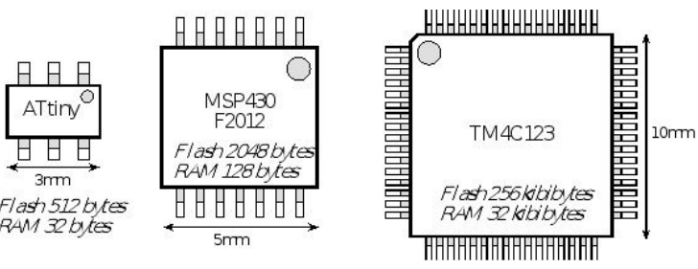
Examples of Micro controller

Slide 4
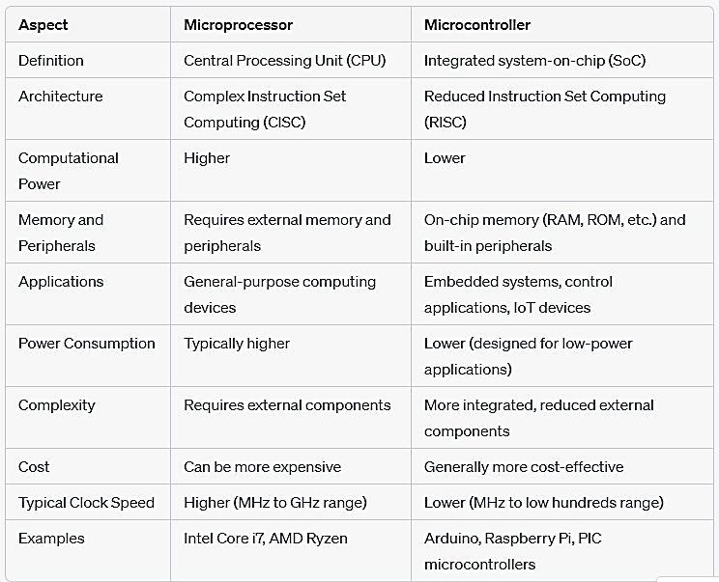
Notes:
Definition:
Microprocessor: A microprocessor is a central processing unit (CPU) that performs arithmetic and logic operations on data. It is a general-purpose processing unit used in computers and other devices.
Microcontroller: A microcontroller is a compact, integrated system-on-chip (SoC) that combines a microprocessor, memory, input/output (I/O) peripherals, and other features. It is designed for specific embedded applications and is often used in control systems.
Architecture:
Microprocessor: Microprocessors are typically based on complex instruction set computing (CISC) architecture, allowing them to execute a wide range of instructions and handle complex tasks efficiently.
Microcontroller: Microcontrollers usually employ reduced instruction set computing (RISC) architecture, which focuses on executing simple instructions quickly, making them well-suited for real-time control applications.
Computational Power:
Microprocessor: Microprocessors tend to have higher computational power and can handle complex algorithms and multitasking efficiently.
Microcontroller: Microcontrollers have relatively lower computational power, but they are sufficient for control applications, sensing, and simple data processing tasks.
Memory and Peripherals:
Microprocessor: Microprocessors require external memory and peripheral chips to form a complete system, increasing the overall system complexity and cost.
Microcontroller: Microcontrollers have on-chip memory (RAM, ROM, and sometimes EEPROM) and built-in peripherals (timers, counters, ADC, DAC, UART, etc.), reducing the need for external components and simplifying the system design.
Applications:
Microprocessor: Microprocessors are commonly used in general-purpose computing devices, such as personal computers, laptops, smartphones, servers, and advanced control systems.
Microcontroller: Microcontrollers find applications in embedded systems, consumer electronics, home appliances, automotive systems, industrial automation, IoT devices, and various control applications.
Power Consumption:
Microprocessor: Microprocessors typically consume more power, especially when running at higher clock speeds, making them less suitable for power-constrained devices.
Microcontroller: Microcontrollers are designed for low-power applications and are more energy-efficient, making them suitable for battery-operated and power-sensitive devices.

Slide 5
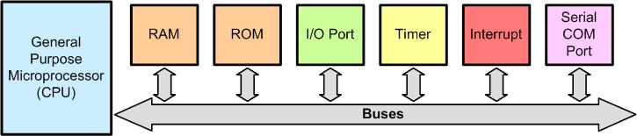
Microprocessors and Microcontrollers
A Computer Made by General Purpose Microprocessor
The microprocessors do not contain RAM, ROM, or I/O peripherals. As a result, they must be connected externally to RAM, ROM and I/O through buses

Slide 6
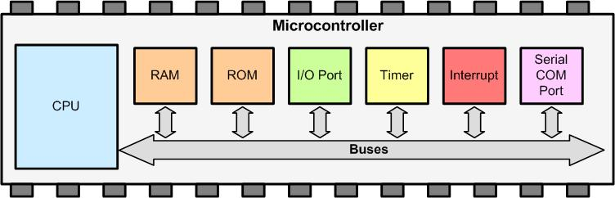
Simplified View of the Internal Parts of Microcontrollers (SOC)
In microcontroller, CPU, RAM, ROM, and I/Os, are put together on a single IC chip and it is called microcontroller. SOC (System on Chip) and MCU (Micro Controller Unit) are other names used to refer to microcontrollers.

Slide 7
ARM has defined the details of architecture, registers, instruction set, memory map, and timing of the ARM CPU and holds the copyright to it.
The various design houses and semiconductor manufacturers license the IP (intellectual property) for the CPU and can add their own peripherals as they please.
It is up to the licensee (design houses and semiconductor manufactures) to define the details of peripherals such as I/O ports, serial port UART, timer, ADC, SPI, DAC, I2C, and so on.
As a result while the CPU instructions and architecture are same across all the ARM chips made by different vendors, their peripherals are not compatible.

Slide 8
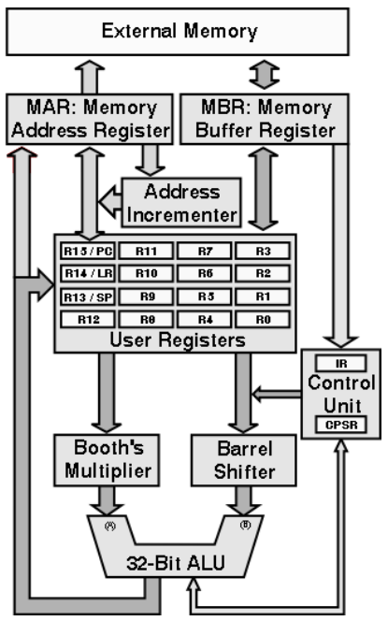
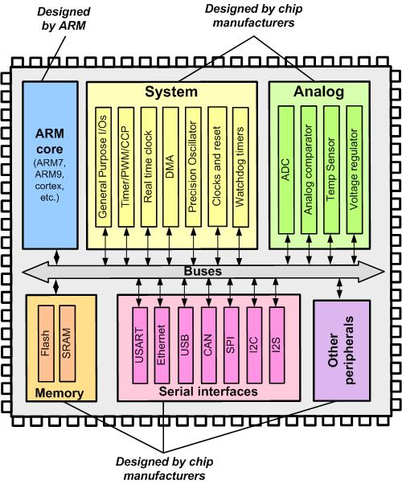
ARM Simplified Block Diagram
Notes:
ARM has defined the details of architecture, registers, instruction set, memory map, and timing of the ARM CPU and holds the copyright to it.
The various design houses and semiconductor manufacturers license the IP (intellectual property) for the CPU and can add their own peripherals as they please. It is up to the licensee (design houses and semiconductor manufactures) to define the details of peripherals such as I/O ports, serial port UART, timer, ADC, SPI, DAC, I2C, and so on.
As a result while the CPU instructions and architecture are same across all the ARM chips made by different vendors, their peripherals are not compatible.
That means if you write a program for the serial port of an ARM chip made by TI (Texas Instrument), the program might not necessarily run on an ARM chip sold by NXP. This is the only drawback of the ARM microcontroller.
The good news is the IDE (integrated development environment) such as Keil (see www.keil.com) or IAR (see www.IAR.com) do provide peripheral libraries for chips from various vendors and make the job of programming the peripherals much easier.
It must be noted that in recent years ARM provides the IP for some peripherals such as Universal Asynchronous Receiver/Transmitter (UART) and SPI, but unlike the CPU architecture, its adoption is not mandatory and it is up to the chip manufacturer whether to adopt it or not.

Slide 9
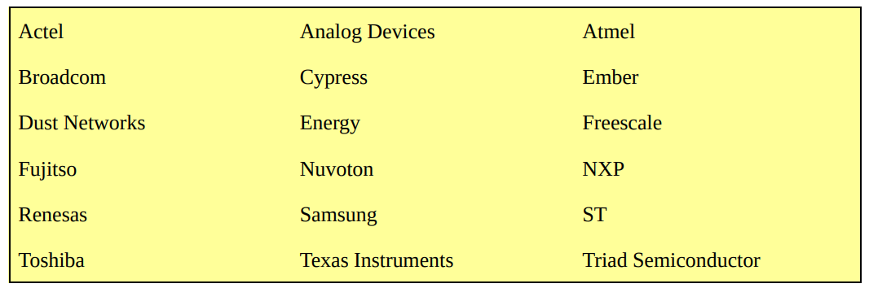

Slide 10
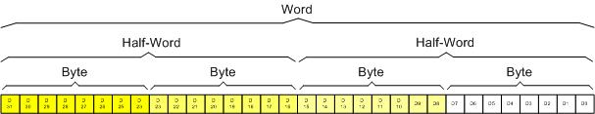
ARM Architecture
ARM supports byte, half word (16 bit) and word (32 bit) data types.
ARM Registers Data Size
Notes:
CPUs use registers to store data temporarily. To program in Assembly language, we must understand the registers and architecture of a given CPU and the role they play in processing data.
ARM microcontrollers have many registers for arithmetic and logic operations. In the CPU, registers are used to store information temporarily.
That information could be a byte of data to be processed, or an address pointing to the data to be fetched. All of ARM registers are 32-bit wide.
The 32 bits of a register are shown in Figure 2-1.

Slide 11
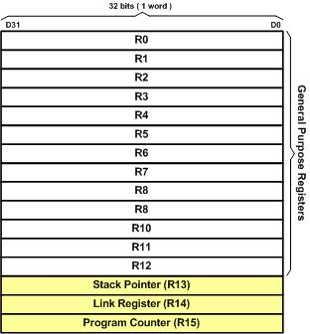
The General Purpose Registers
ARM Registers
Notes:
These range from the MSB (most-significant bit) D31 to the LSB (least-significant bit) D0.
With a 32- bit data type, any data larger than 32 bits must be broken into 32-bit chunks before it is processed.
Although the ARM default data size is 32-bit many assemblers also support the single bit, 8-bit, and 16-bit data types, as we will see in future chapters.
The 32-bit data size of the ARM is often referred as word. This is in contrast to x86 CPU in which word is defined as 16-bit.
In ARM the 16-bit data is referred to as half-word.
Therefore ARM supports byte, half-word (two byte), and word (four bytes) data type

Slide 12
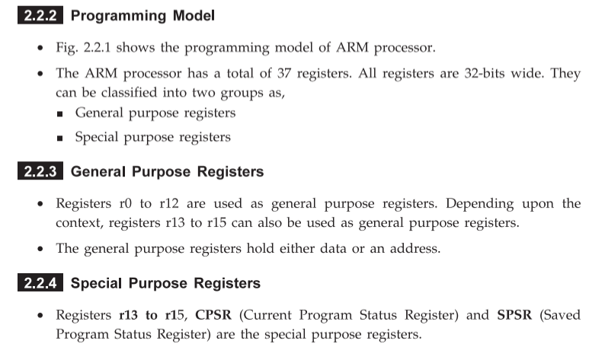

Slide 13
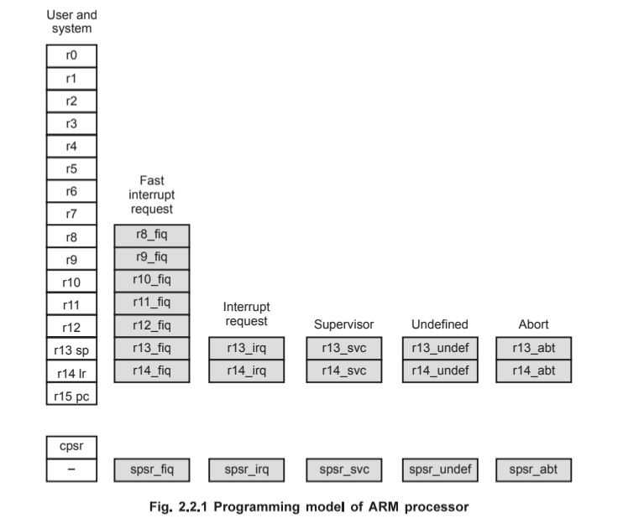

Slide 14
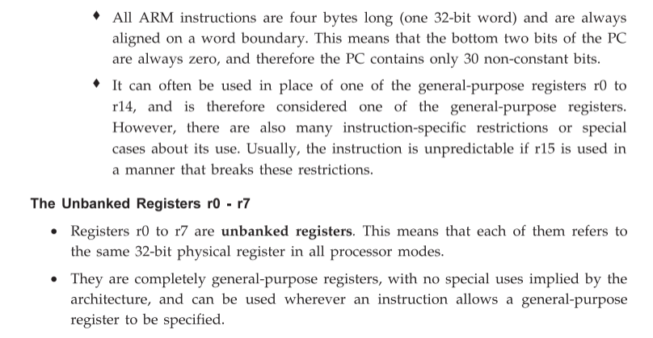

Slide 15
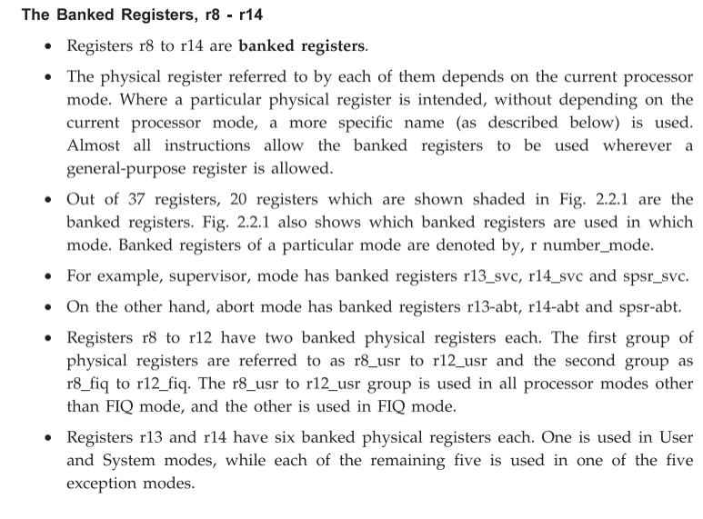

Slide 16
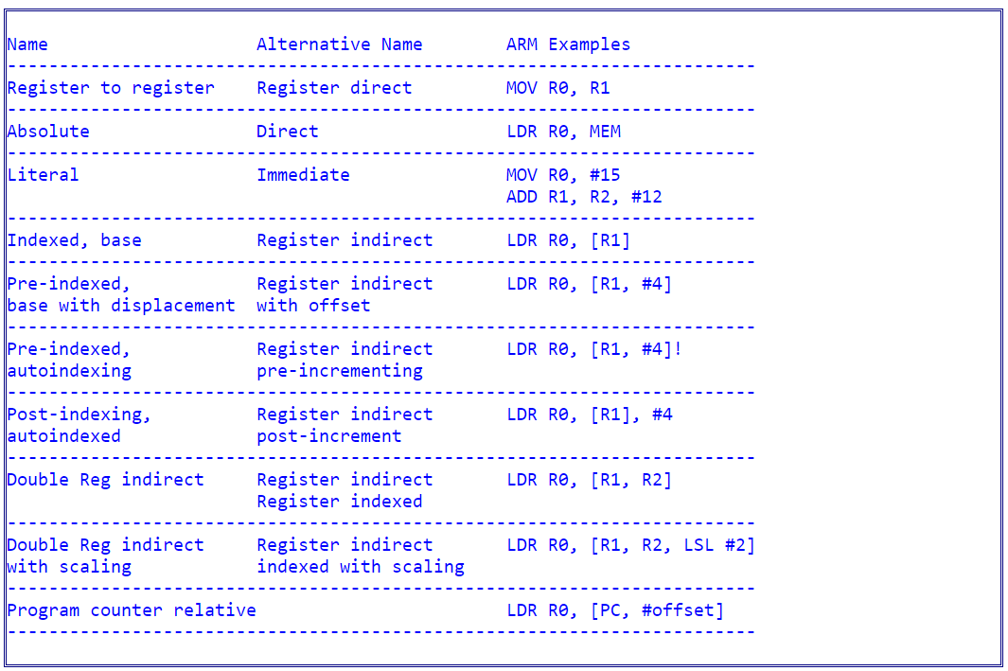

Slide 17
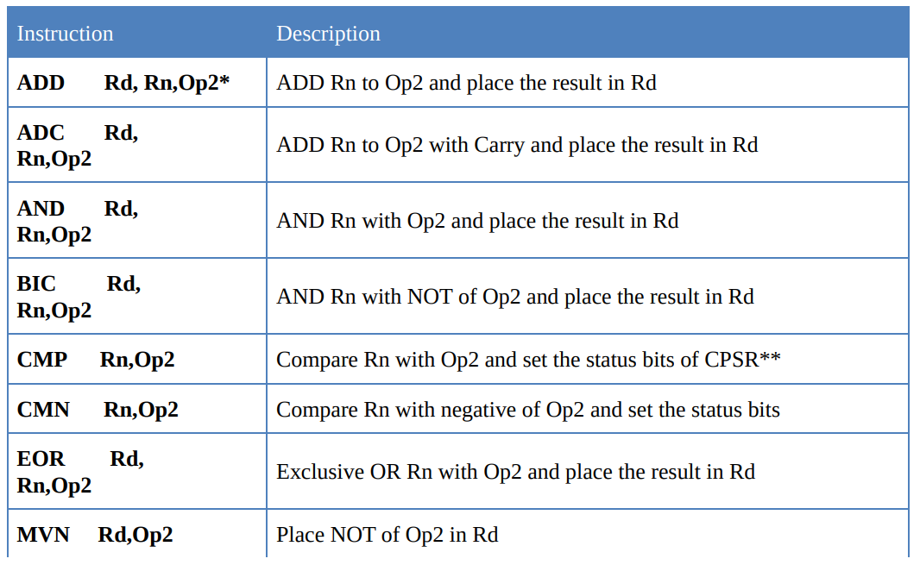
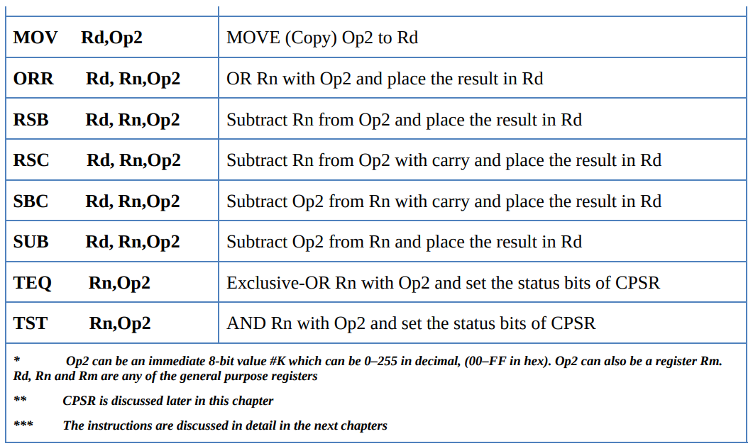

Slide 18
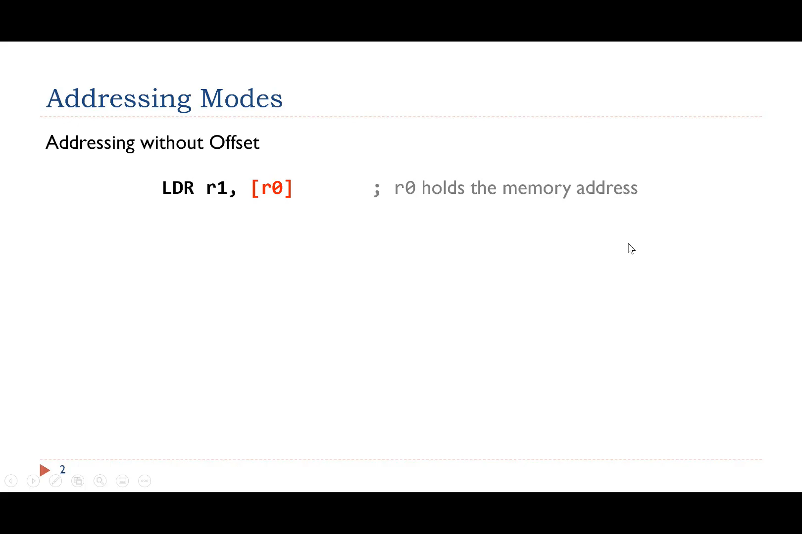

Slide 19
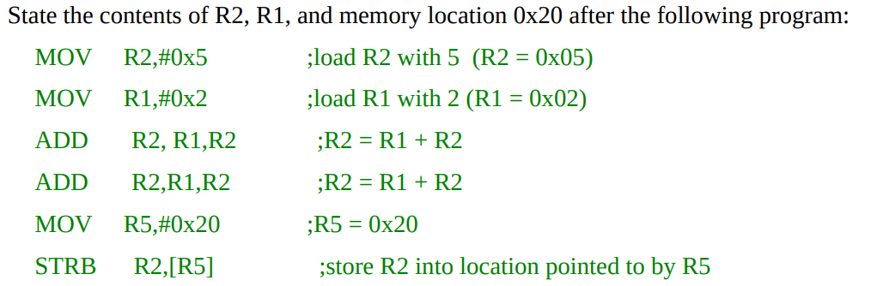
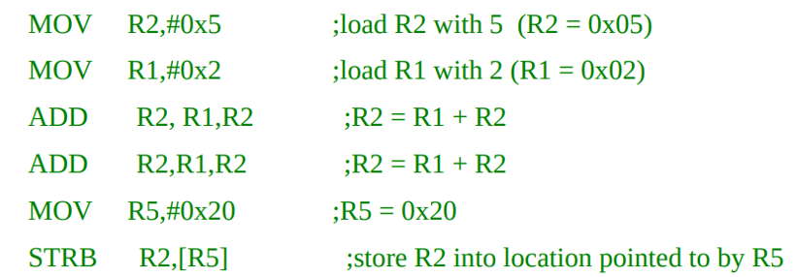

Slide 20
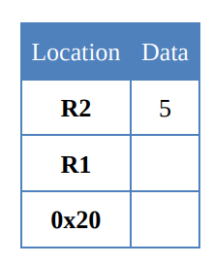
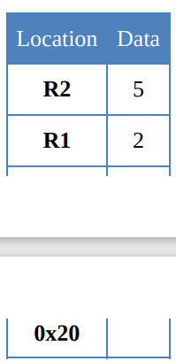
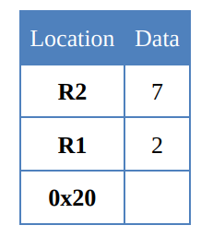
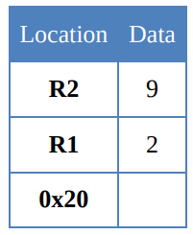
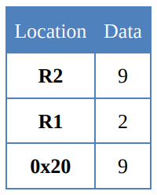

Slide 21
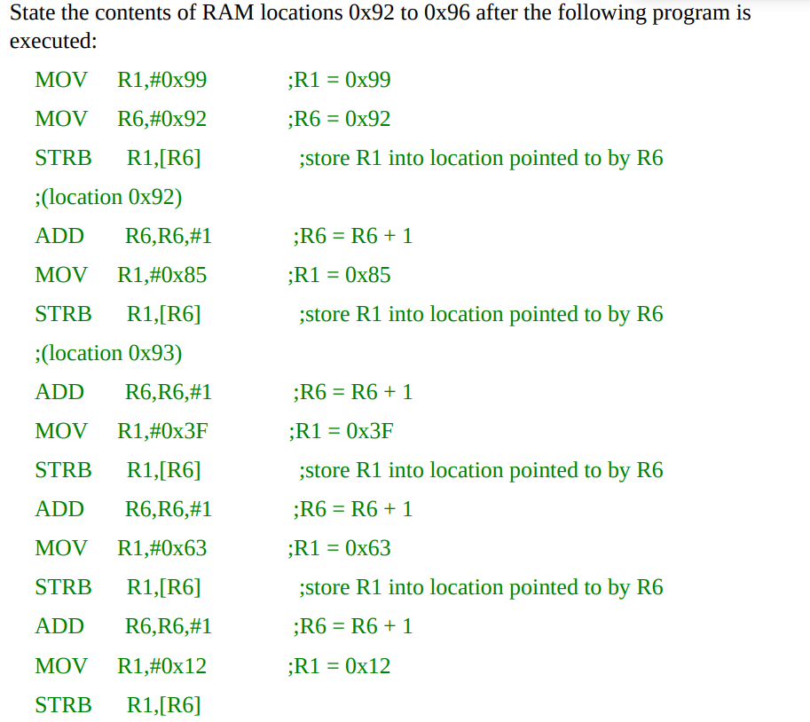

Slide 22
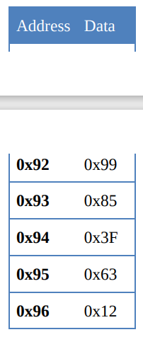

Slide 23
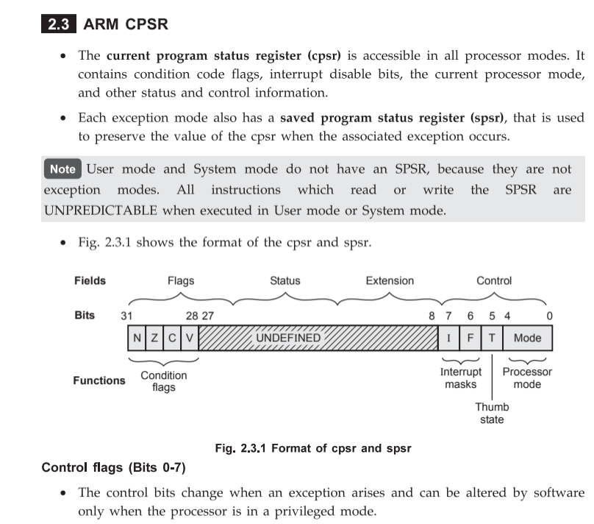

Slide 24
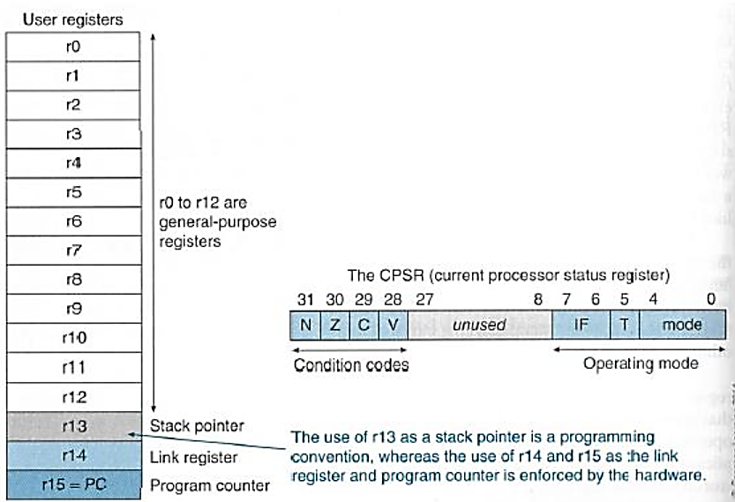
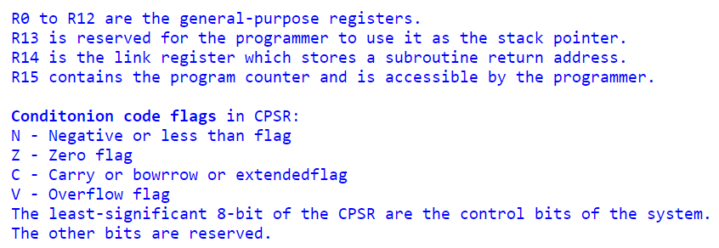

Slide 25
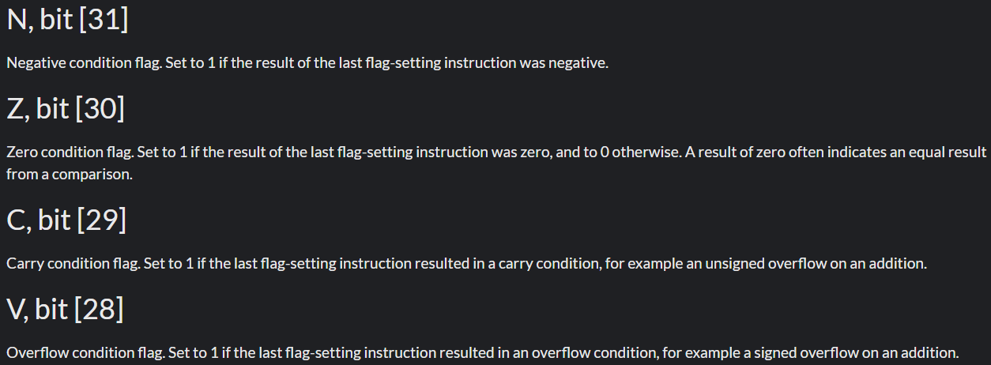

Slide 26
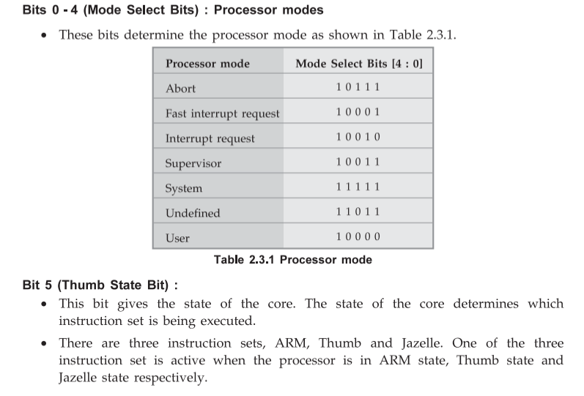

Slide 27
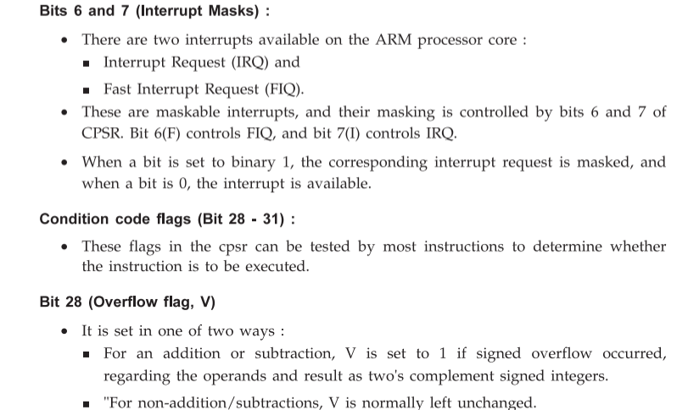

Slide 28
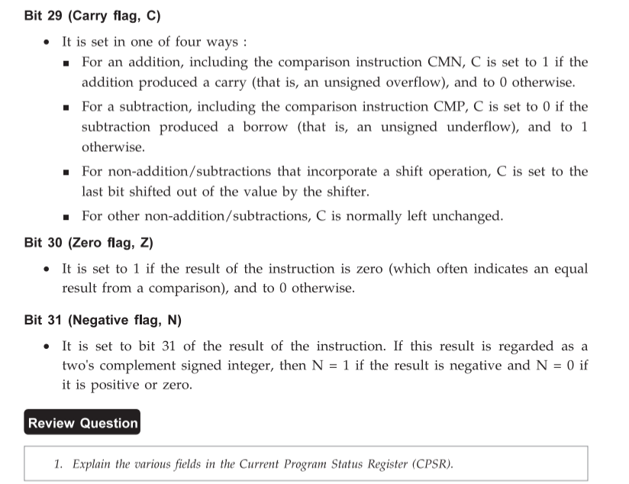

Slide 29
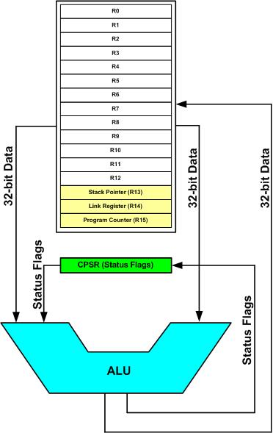
The Special Function Registers in ARM
ARM Registers and ALU

Slide 30
In ARM the R13, R14, R15, and CPSR (current program status register) registers are called SFRs (special function registers) since each one is dedicated to a specific function. A given special function register is dedicated to specific function such as status register, program counter, stack pointer, and so on. The function of each SFR is fixed by the CPU designer at the time of design because it is used for co ntrol of the microcontroller or keeping track of specific CPU status.
The R13 is set aside for stack pointer. The R14 is designated as link register which holds the return address when the CPU calls a subroutine
and the R15 is the program counter (PC). The PC (program counter) points to the address of the next instruction to be executed. The CPSR (current program status register) is used for keeping condition flags among other things. In contrast to SFRs, the GPRs (R0-R12) do not have any specific function and are used for storing general data.

Slide 31
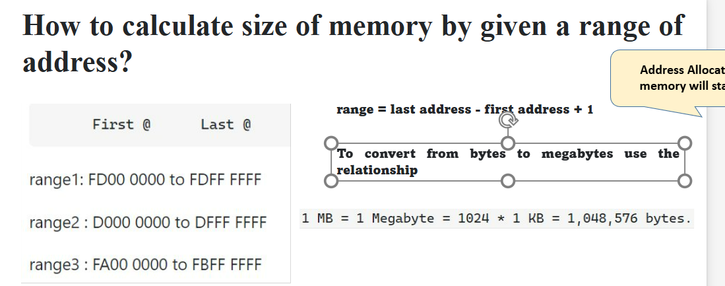
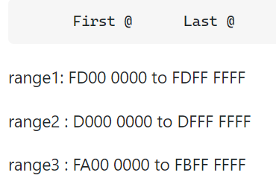
How to calculate size of memory by given a range of address?
Address Allocations in the memory will start from ‘0’
range = last address - first address + 1
To convert from bytes to megabytes use the relationship

Slide 32
A given ARM chip has the following address assignments. Calculate the space and the
amount of memory given to each section.
(a) Address range of 0x00100000 – 0x00100FFF for EEPROM
(b) Address range of 0x40000000 – 0x40007FFF for SRAM
(c) Address range of 0x00000000 – 0x0007FFFF for Flash
(d) Address range of 0xFFFC0000 – 0xFFFFFFFF for peripherals
Solution:
(a) With address space of 0x00100000 to 00100FFF, we have 00100FFF – 00100000 =
0FFF bytes. Converting 0FFF to decimal, we get 4,095 + 1, which is equal to 4K bytes.
(b) With address space of 0x40000000 to 0x40007FFF, we have 40007FFF – 40000000 =
7FFF bytes. Converting 7FFF to decimal, we get 32,767 + 1, which is equal to 32K bytes.
(c) With address space of 0000 to 7FFFF, we have 7FFFF – 0 = 7FFFF bytes. Converting
7FFFF to decimal, we get 524,287 + 1, which is equal to 512K bytes.
(d) With address space of FFFC0000 to FFFFFFFF, we have FFFFFFFF–FFFC0000 =
3FFFF bytes. Converting 3FFFF to decimal, we get 262,143 + 1, which is equal to 256K
bytes.

Slide 33
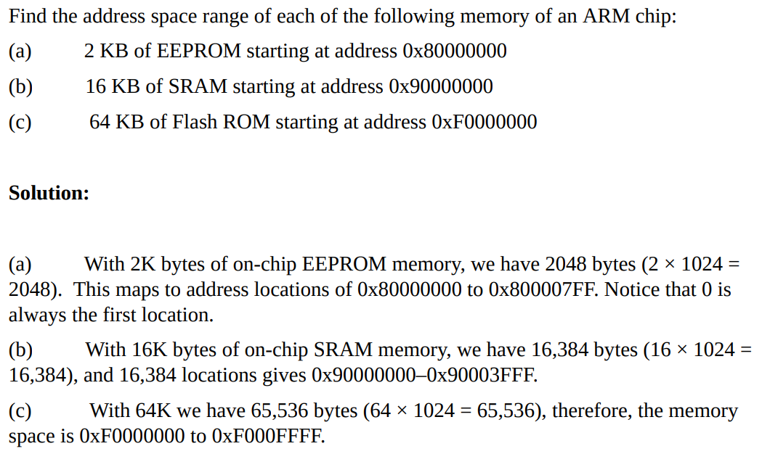

Slide 34
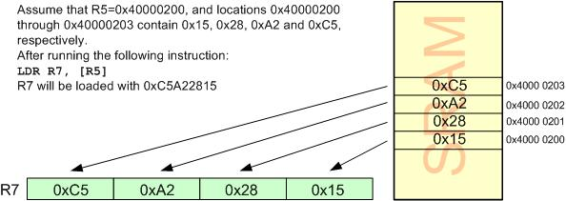
Load and Store Instructions in ARM
Every instruction of ARM is fixed at 32-bit. The fixed size instruction is one of the most important characteristics of RISC architecture.
LDR Rd, [Rx] instruction
;load Rd with the contents of location pointed to by Rx register.
Executing the LDR Instruction
Notes:
The LDR instruction tells the CPU to load (bring in) one word (32-bit or 4 bytes) from a base address pointed to by Rx into the GPR.
After this instruction is executed, the Rd will have the same value as four consecutive locations in the memory.
Obviously since each memory location can hold only one byte (ARM is a byte addressable CPU), and our GPR is 32-bit, the LDR will bring in 4 bytes of data from 4 consecutive memory locations.
The locations can be in the SRAM or a Flash memory. For example, the “LDR R2,[R5]” instruction will copy the contents of memory locations pointed to by R5 into register R2.
Since the R2 register is 32-bit wide, it expects a 32-bit operand in the range of 0x00000000 to 0xFFFFFFFF.
That means the R5 register gives the base address of the memory in which it holds the data.
Therefore if R5=0x80000, the CPU will fetch into register R2, the contents of memory locations 0x80000, 0x80001,0x80002, and 0x80003.

Slide 35
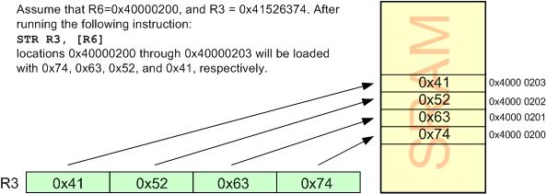
STR Rx,[Rd] instruction
;store register Rx into locations pointed to by Rd
Executing the STR Instruction
Notes:
The STR instruction tells the CPU to store (copy) the contents of the GPR to a base address location pointed to by the Rd register.
Notice that the source register of STR instruction is placed before the destination register.
Obviously since GPR is 32-bit wide (4-byte) we need four consecutive memory locations to store the contents of GPR.
The memory locations must be writable such as SRAM. See Figure 2-6.
The “STR R3,[R6]” instruction will copy the contents of R3 into locations pointed to by R6.
Locations 0x40000200 through 0x40000203 of the SRAM memory will have the contents of R3 since R6 = 0x40000200.

Slide 36
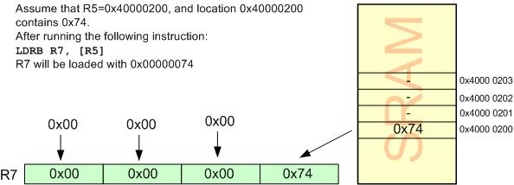
LDRB Rd, [Rx] instruction
;load Rd with the contents of the location pointed to by Rx register. After this instruction is executed, the lower byte of Rd will have the same value as memory location pointed to by Rx. The upper 24 bits of the Rd register will be all zeros
executing the LDRB Instruction
Notes:
The LDRB instruction tells the CPU to load (copy) one byte from an address pointed to by Rx into the lower byte of Rd.
After this instruction is executed, the lower byte of Rd will have the same value as memory location pointed to by Rx.
It must be noted that the unused portion (the upper 24 bits) of the Rd register will be all zeros, as shown in Figure 2-7.

Slide 37
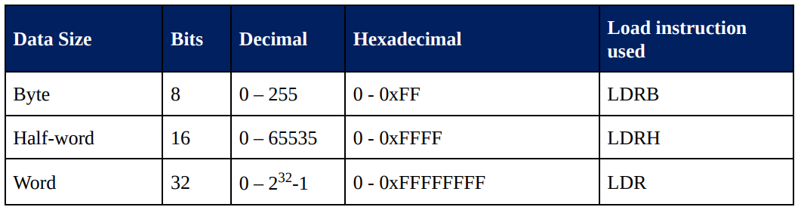

Slide 38
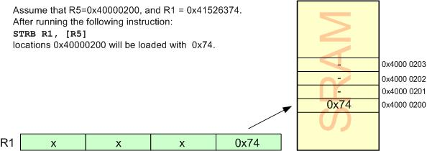
STRB Rx,[Rd] instruction
;store the byte in register Rx into location pointed to by Rd
Executing the STRB Instruction
Notes:
The STRB instruction tells the CPU to store (copy) the byte value in Rx to an address location pointed to by the Rd register.
After this instruction is executed, the memory locations pointed to by the Rd will have the same byte as the lower byte of the Rx, as shown in Figure 2-8.

Slide 39
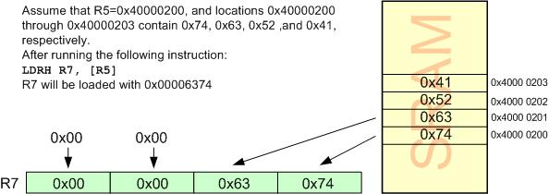
LDRH Rd, [Rx] instruction
;load Rd with the half-word (16-bit or 2 bytes) pointed to by Rx register
Executing the LDRH Instruction
Notes:
The LDRH instruction tells the CPU to load (copy) half-word (16-bit or 2 bytes) from a base address pointed to by Rx into the lower 16-bits of Rd Register.
After this instruction is executed, the lower 16-bit of Rd will have the same value as two consecutive locations in the memory pointed to by base address of Rx. It must be noted that the unused portion (the upper 16 bits) of the Rd register will be all zeros, as shown in Figure 2-9.

Slide 40
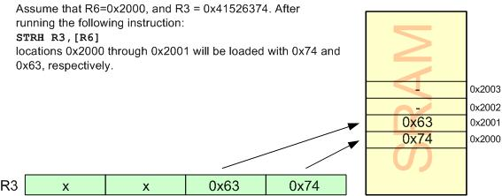
STRH Rx,[Rd] instruction
;store half-word (2-byte) in register Rx into locations pointed to by Rd
Executing the STRH Instruction
Notes:
The STRH instruction tells the CPU to store (copy) the lower 16-bit contents of the Rx to an address location pointed to by the Rd register.
After this instruction is executed, the memory locations pointed to by the Rd will have the same value as the lower 16-bit of Rx Register.
The locations are part of the data read/write memory space such as on-chip SRAM.
For example, the “STRH R3,[R6]” instruction will copy the 16-bit lower contents of R3 into two consecutive locations pointed to by base register R6.
As you can see in Figure 2-10, locations 0x2000 and 0x2001 of the SRAM memory will have the contents of the lower half word of R3 since R6 = 0x2000.

Slide 41
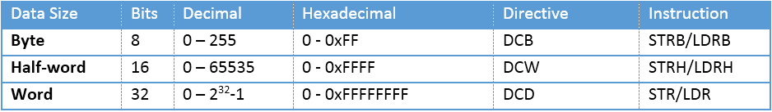
Little endian vs. big endian
In the big endian method, the high byte goes to the low address, whereas in the little endian method, the high byte goes to the high address and the low byte to the low address.
Unsigned Data Range in ARM and associated Instructions

Slide 42
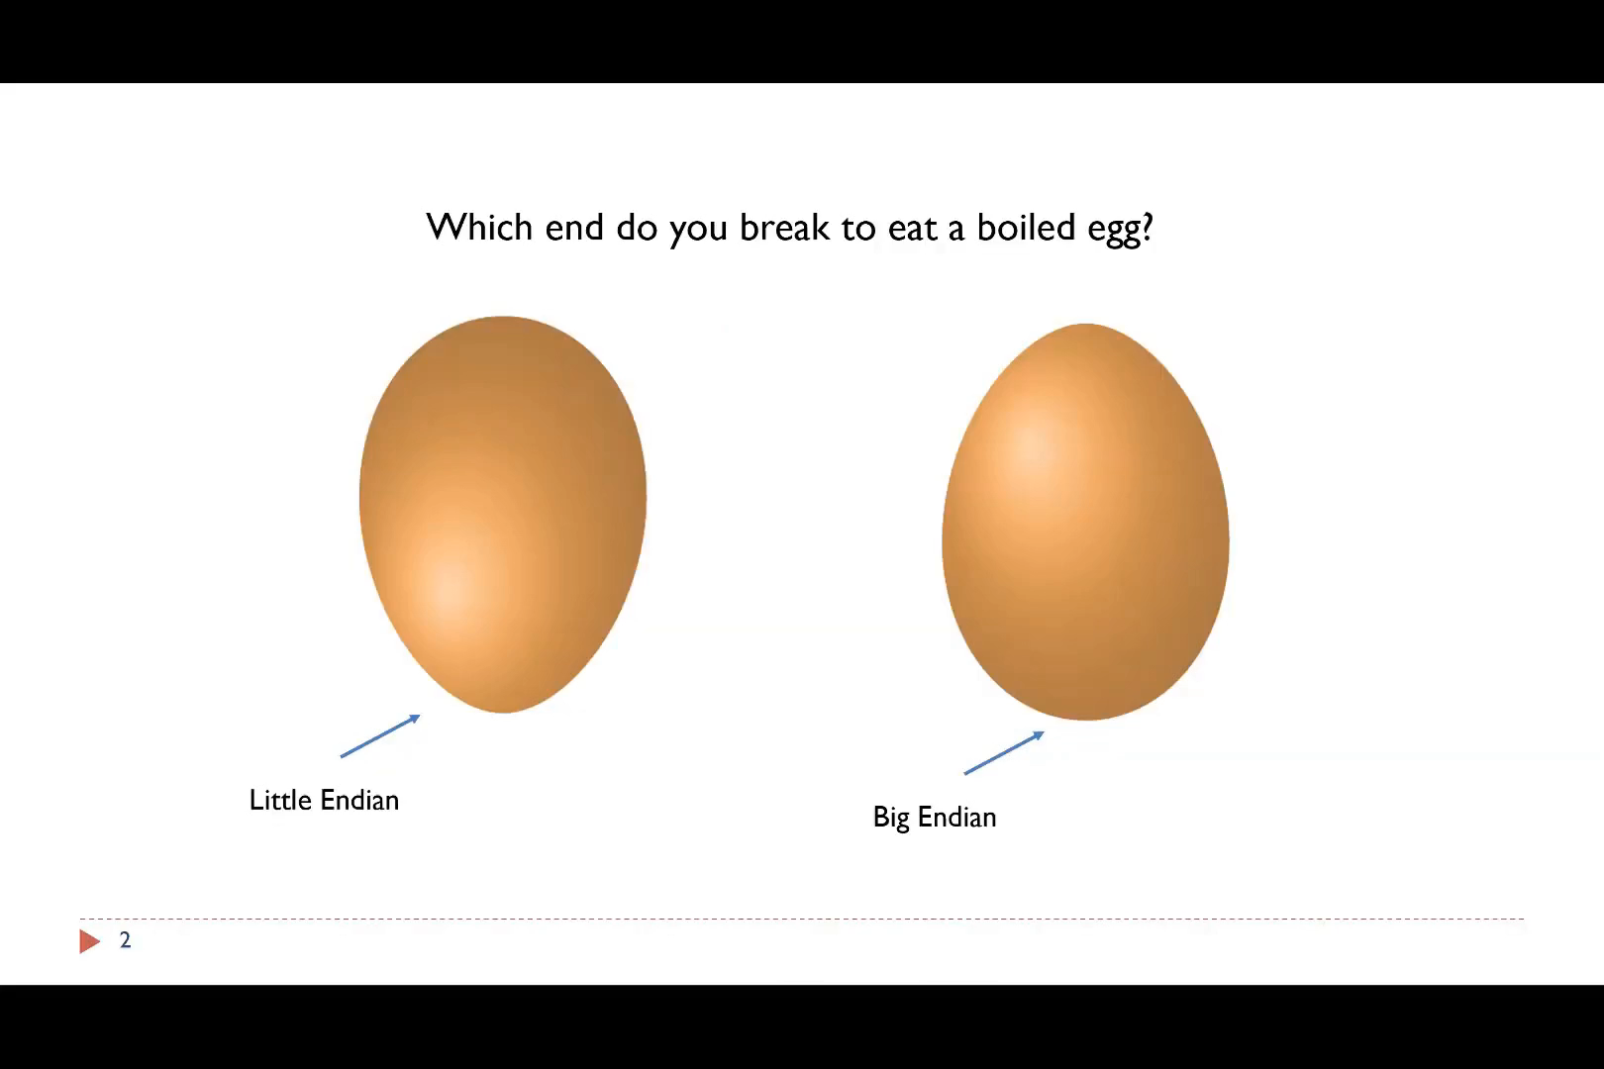

Slide 43
This area is dedicated to general purpose I/O (GPIO) and special function registers (SFRs) of peripherals such as timers, serial communication, ADC, and so on.
A RAM space ranging from a few kilobytes to several hundred kilobytes is set aside mainly for data storage. The data RAM space is used for data variables and stack and is accessed by the microcontroller instructions.
The program space is used for the program code. In ARM microcontroller chips, the code ROM space is of Flash type memory.

Slide 44
Memory space allocation in the ARM
The ARM has 4G bytes of directly accessible memory space. This memory space has addresses 0 to 0xFFFFFFFF. The 4G bytes of memory space can be divided into five sections. They are as follows:
On-chip peripheral and I/O registers: This area is dedicated to general purpose I/O (GPIO) and special function registers (SFRs) of peripherals such as timers, serial communication, ADC, and so on. In other words, ARM uses memory-mapped I/O.
On-chip data SRAM: A RAM space ranging from a few kilobytes to several hundred kilobytes is set aside mainly for data storage. The data RAM space is used for data variables and stack and is accessed by the microcontroller instructions.
On-chip EEPROM: A block of memory from 1K bytes to several thousand bytes is set aside for EEPROM memory.

Slide 45
4. On-chip Flash ROM: A block of memory from a few kilobytes to several hundred kilobytes is set aside for program space. The program space is used for the program code.
5. Off-chip DRAM space: A DRAM memory ranging from few megabytes to several hundred mega bytes can be implemented for external memory connection.

Slide 46
ARM CPSR (Current Program Status Register)
CPSR (Current Program Status Register)
S suffix and the status register
Most of ARM instructions can affect the status bits of CPSR according to the result. If we need an instruction to update the value of status bits in CPSR, we have to put S suffix at the end of instructions. That means, for example, ADDS instead of ADD is used.

Slide 48
C, the carry flag
This flag is set whenever there is a carry out from the D31 bit. This flag bit is affected after a 32-bit addition or subtraction.
Z, the zero flag
The zero flag reflects the result of an arithmetic or logic operation. If the result is
zero, then Z = 1. Therefore, Z = 0 if the result is not zero.
N, the negative flag
The negative flag reflects the result of an arithmetic operation. If the D31 bit of the result is zero, then N = 0 and the result is positive. If the D31 bit is one, then N = 1 and the result is negative. The negative and V flag bits are used for the signed number arithmetic operations
V, the overflow flag
This flag is set whenever the result of a signed number operation is too large, causing the high-order bit to overflow into the sign bit. In general, the carry flag is used to detect errors in unsigned arithmetic operations while the overflow flag is used to detect errors in signed arithmetic operations.
The T flag bit is used to indicate the ARM is in Thumb state. The I and F flags are used to enable or disable the interrupt.

Slide 49
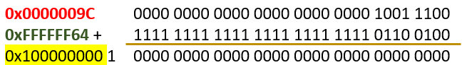
Show the status of the C and Z flags after the addition of
0x0000009C and 0xFFFFFF64
0x0000009C and 0xFFFFFF69
C = 1 because there is a carry beyond the D31 bit.
Z = 1 because the R2 (the result) has value 0 in it after the addition.
;assume
R1 = 0x0000009C and
R2 = 0xFFFFFF64
ADDS R2,R1,R2
;add R1 to R2 and place the result in R2

Slide 50
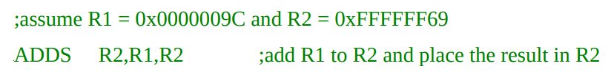

Show the status of the C and Z flags after the addition of
0x0000009C and 0xFFFFFF64
0x0000009C and 0xFFFFFF69
C = 1 because there is a carry beyond the D31 bit.
Z = 0 because the R2 (the result) does not have value 0 in it after the addition. (R2=0x00000005)

Slide 51



Slide 52


Table : shows the instructions and the flag bits affected by them.
There are instructions that will make a conditional jump (branch) based on the status of the flag bits.

Slide 53


Slide 54
ARM Data Format
ARM data type
ARM has four data types. They are bit, byte (8-bit), half-word (16-bit) and word (32 bit).
Data format representation
There are several ways to represent a byte of data in the ARM assembler. The numbers can be in hex, binary, decimal, or ASCII formats.
Hex numbers
To represent Hex numbers in an ARM assembler we put 0x (or 0X) in front of the number
MOV R1,#0x99
Decimal numbers
To indicate decimal numbers in some ARM assemblers such as Keil we simply use the decimal (e.g., 12) and nothing before or after it.
MOV R7,#12

Slide 55
Binary numbers
To represent binary numbers in an ARM assembler we put 2_ in front of the number.
MOV R6,#2_10011001
Numbers in any base between 2 and 9
To indicate a number in any base n between 2 and 9 in an ARM assembler we simply use the n_ in front of it.
ASCII characters
To represent ASCII data in an ARM assembler we use single quotes as follows:
LDR R3,#‘2’ ;R3 = 00110010 or 32 in hex. ASCII of 2.
To represent a string, double quotes are used; and for defining ASCII strings (more than one character), we use the DCB directive.

Slide 56
ARM assembly language module
An ARM assembly language module has several constituent parts. These are:
Extensible Linking Format (ELF) sections (defined by the AREA directive).
Application entry (defined by the ENTRY directive).
Program end (defined by the END directive).
Assembler Directives
Assembler directives are the commands to the assembler that direct the assembly
process.
They do not generate any machine code i.e. they do not contribute to the final size
of machine code and they are assembler specific
AREA:
The AREA directive tells the assembler to define a new section of memory. The memory can be code (instructions) or data and can have attributes such as READONLY, READWRITE and so on. This is used to define one or more blocks of indivisible memory for code or data to be used by the linker. The following is the format:
AREA sectionname attribute, attribute, …

Slide 57
The following line defines a new area named mycode which has CODE and
REASDONLY attributes:
AREA mycode, CODE, READONLY
Commonly used attributes are CODE, DATA, READONLY, READWRITE
READONLY:
It is an attribute given to an area of memory which can only be read from. It is by default for CODE. This area is used to write the instructions.
READWRITE:
It is attribute given to an area of memory which can be read from and written to. It is by default for DATA.
CODE:
It is an attribute given to an area of memory used for executable machine instructions. It is by default READONLY memory.

Slide 58
DATA:
It is an attribute given to an area of memory used for data and no instructions can be placed in this area. It is by default READWRITE memory.
ALIGN:
It is used to indicate how memory should be allocated according to the addresses. When the ALIGN is used for CODE and READONLY, it is
aligned in 4-bytes address boundary by default since the ARM instructions are 32 bit word. If it is written as ALIGN = 3, it indicates that the information should be placed in memory with addresses of 2³, that is for example 0x50000, 0x50008, 0x50010, 0x50018
and so on.
EXPORT:
The EXPORT directive declares a symbol that can be used by the linker to resolve symbol references in separate object and library files.

Slide 59
DCD (Define constant word):
Allocates a word size memory and initializes the values. Allocates one or more words of memory, aligned on 4-byte boundaries and defines initial run time contents of the memory.
ENTRY:
The ENTRY directive declares an entry point to the program. It marks the first instruction to be executed. In applications using the C library, an entry point is also contained within the C library initialization code. Initialization code and exception handlers also contain entry points
END:
It indicates to the assembler the end of the source code. The END directive is the last line of the ARM assembly program and anything after the END directive in the source file is ignored by the assembler.
EQU:
Associate a symbolic name to a numeric constant.
RN (equate)
This is used to define a name for a register. The RN directive does not set aside a seperate storage for the name, but associates a register with that name. It improves the
clarity.
VAL1 RN R1 ;define VAL1 as a name for R1

Slide 60
SPACE directive
Using the SPACE directive we can allocate memory for variables.
LONG_VAR SPACE 4 ;Allocate 4 bytes
OUR_ALFA SPACE 2 ;Allocate 2 bytes
Pseudo Instructions:
LDR Pseudo Instruction
LDR Rd,=32-bit_immidiate_value
Notice the = sign used in the syntax. The following pseudo-instruction loads R7 with 0x112233.
LDR R7, =0x112233
To load values less than 0xFF, “MOV Rd, #8-bit_immidiate_value” instruction is used since it is a real instruction of ARM, therefore more efficient in code size.
ADR Pseudo Instruction
To load registers with the addresses of memory locations we can also use the ADR
pseudo-instruction which has a better performance. ADR has the following syntax:
ADR Rn, label
ADR R2, OUR_FIXED_DATA ;point to OUR_FIXED_DATA

Slide 61
An Assembly language instruction consists of four fields:
[label] mnemonic [operands] [;comment]
The first column of each line is always considered as label. Thus, be careful to press a Tab at the beginning of each line that does not have label; otherwise, your instruction is considered as a label and an error message will appear when compiling.

Slide 62


Slide 63


Slide 64


Slide 65

Harvard and von Neumann architectures in the ARM
In von Neumann, there are no separate buses for code and data memory. In Harvard, there are separate buses for code and data memory.

Slide 66
When the CPU wants to execute the “LDR Rd,[Rx]” instruction, it puts Rx on the address bus of the system, and receives data through the
data bus. For example, to execute “LDR R2,[R5]”, assuming that R5 = 0x40000200, the CPU puts the value of R5 on the address bus. The Memory puts the contents of location 0x40000200 on the data
bus. The CPU gets the contents of location 0x40000200 through the data bus and brings into CPU and puts it in R2.
The “STR Rx,[Rd]” instruction is executed similarly. The CPU puts Rd on the address bus and the contents of Rx on the data bus. The memory location whose address is on the address bus receives the contents of data bus.

Slide 67
Addressing modes
------------------------------------------------------------------------
Register to register (Register direct) MOV R0, R1
------------------------------------------------------------------------
Absolute (Direct) LDR R0, MEM
------------------------------------------------------------------------
Literal (Immediate) MOV R0, #15
ADD R1, R2, #12
------------------------------------------------------------------------
Indexed, base (Register indirect) LDR R0, [R1]
------------------------------------------------------------------------
Pre-indexed, base with displacement (Register indirect with offset)
LDR R0, [R1, #4] ;Load R0 from [R1+4]
LDR R0, [R1, #-4]
------------------------------------------------------------------------

Slide 68
Pre-indexed with autoindexing (Register indirect with pre-incrementing)
LDR R0, [R1, #4]! ; Load R0 from [R1+4], R1 = R1 +4
------------------------------------------------------------------------
Post-indexing with autoindexed (Register indirect with post-increment)
LDR R0, [R1], #4 ; Load R0 from [R1], R1 = R1 +4
------------------------------------------------------------------------
Double Reg indirect (Register indirect indexed)
LDR R0, [R1, R2] ; Load R0 from [R1 + R2]
------------------------------------------------------------------------
Double Reg indirect with scaling (Register indirect indexed with scaling)
LDR R0, [R1, R2, LSL #2]
------------------------------------------------------------------------
Program counter relative LDR R0, [PC, #offset]
---------------------------------------------------------------------

Slide 69
RISC Features
Fixed Instruction Size(Helps Inst. Decoder)
Large no of registers(less memory operations)
Smaller inst. Set
Single clock cycle inst. Execution
Hardwiring
Load/Store Architecture

Slide 70

Notes:
A Reduced Instruction Set Computer is a type of microprocessor architecture that utilizes a small, highly-optimized set of instructions rather than the highly-specialized set of instructions typically found in other architectures. RISC is an alternative to the Complex Instruction Set Computing (CISC) architecture and is often considered the most efficient CPU architecture technology available today.
allows developers to increase the register set and increase internal parallelism by increasing the number of parallel threads executed by the CPU and increasing the speed of the CPU's executing instructions.
Processors based on this architecture are common in smartphones, tablets, laptops, gaming consoles and desktops, as well as a growing number of other intelligent devices.
RISC provides high performance per watt for battery operated devices where energy efficiency is key. A RISC processor executes one action per instruction. By taking just one cycle to complete, operation execution time is optimized.

Slide 71


Slide 72


Slide 73



Slide 74

Some Widely Used ARM Memory Allocation Directives

